Slide 1
Module 3
Increasing Independence and Confidence Around Sleep Through Choice
Madison Bowen
Occupational Therapy Student at the University of Alabama at Birmingham

Slide 2
01
02
What is Routine & Sleep Hygiene
Creating A Sleep Routine
03
04
Strategies to Facilitate Sleep
Do’s, Don’ts, and Maybes of Sleep

Slide 3
01
What is Routine and Sleep Hygiene?

Slide 4
What Is Sleep Hygiene?
Sleep Hygiene can be defined as any modifiable aspect of the child and parents routines. It can also encompass practices and preparation of the environment that encourages quality sleep and duration.
Changes in routine and practices can include: grooming, bathing, dressing, reading, screen time, prayers and listening to music.

Slide 5
Bedtime routines involving activities that are done daily may support or hinder sleep based on the child’s preferences or sensory needs
Notes:
Add example to script

Slide 6
Routine
Routines are important for all children! They are essential for children who have experienced trauma and/or maltreatment.
Established sequences of activities that provide the structure for daily life.
Regulate pre-sleep arousal
Provide a sense of stability and control
Facilitate emotional bond with caregivers

Slide 7
Sleep Routine
Family routines are characterised by communication, a momentary time commitment, and are repeated regularly.
Keep your foster child’s cultural and sensory needs in mind when crafting their sleep routine.
Consistency is key! A bedtime routine that is consistent will signal relaxation to the body and cause the body to produce melatonin.
Notes:
Consider a selection of the same books
Bath starting at a consistent time every night

Slide 8
Sleep Routine
When establishing the sleep routine for a new child in your home, ask the former guardian or social worker about the child’s sleep routine if possible.
If the child is old enough, ask the child directly.
Sample Questions You Could Ask:
Do they have a safety item such as a stuffed animal or blanket?
When do they normally go to sleep?
Do they sleep with a sibling in the room normally?
Do they have a nightlight?
Notes:
This is important to create a sense of familiarity and safety! If not possible, trial and error is the best strategy. If the child is old enough, ask what they had at home.

Slide 9
02
Creating A Sleep Routine

Slide 10
How To Structure A Sleep Routine: Meal Time
Dinner should be eaten 2-4 hours before bed
Note: If a child is hungry after dinner, feed them!
However, a snack before bed can help children fall asleep faster and stay asleep

Slide 11
How To Structure A Sleep Routine: Meal Time
What To Eat
Tart Cherry Juice
Kiwi
Walnuts
Almonds
Milk or Powdered Milk
Oats
Bananas
What To Avoid
Spicy Foods
Foods High In Fat
Fried Foods
Full Fat Dairy Products
Fatty Meats
Acidic Foods
Caffeine
Notes:
Research shows that eating high calorie meals before bed with large amounts of fats or carbohydrates increases the time it takes to fall asleep.

Slide 12
How To Structure A Sleep Routine: Blue Light
What is “Blue Light”
The light that normally comes from LED lights or digital screens.
During the day being exposed to light via the sun or from blue light promotes energy and concentration!
However, using devices that produce the artificial blue light before bed in the evening or nighttime disrupts our sleep-wake cycle.

Slide 13
How To Structure A Sleep Routine: Blue Light
What is “Blue Light”
The pineal gland produces melatonin in our body in response to darkness.
Blue light tricks our bodies into thinking it is still day and inhibiting sleep.
Screen time should ideally be ended 60 minutes before bed and lights should be dimmed to encourage the production of melatonin.
Notes:
Melatonin is a hormone that promotes the feeling of sleepiness.

Slide 14
How To Structure A Sleep Routine: Blue Light
Appropriate Lighting
Nighttime fear is a common occurrence in children and can often be lessened with a nightlight.
It has been proven that red light has no effect on the production of melatonin.
Yellow and orange have little effect.
If the device is necessary for the feeling of safety, blue light glasses will limit exposure.

Slide 15
How To Structure A Sleep Routine: Physical Activity
Physical Activity decreases sleep latency or the time it takes to fall asleep.
Therefore increasing overall sleep time.
Morning or afternoon physical activity is most effective to facilitate sleep. In fact, evening or nighttime exercise has a negative effect on sleep.

Slide 16
03
Strategies To Facilitate Sleep

Slide 17
Sleep Environment For Children
Optimal temperature 70 degrees or cooler
Making the bedroom a no screen zone.
Red, Yellow, or Orange Lighting if needed. Otherwise, no lighting.
Minimizing Noise
Utilize comfort items and soft relaxing music

Slide 18
Safe Sleep Environment For Babies
Always place the baby on their back for sleeping including nap time.
Do not place pillows, blankets, toys etc in the crib with baby. The crib should be a firm flat surface.
Do not smoke or let anyone smoke around your baby.
Baby should not nap on a couch or adult bed even when an adult is present.
Dress baby in sleep clothing not covering their head.
Notes:
To prevent sudden infant death syndrome or SIDs

Slide 19
Sleep Environment: Smell
Smell can affect and influence sleep quality, quantity, and latency.
Sensitivity to smell can change throughout the day and lower sensitivity at night actually can help you sleep.
Example: Lavender has a calming effect on blood pressure, mood, and heart rate.

Slide 20
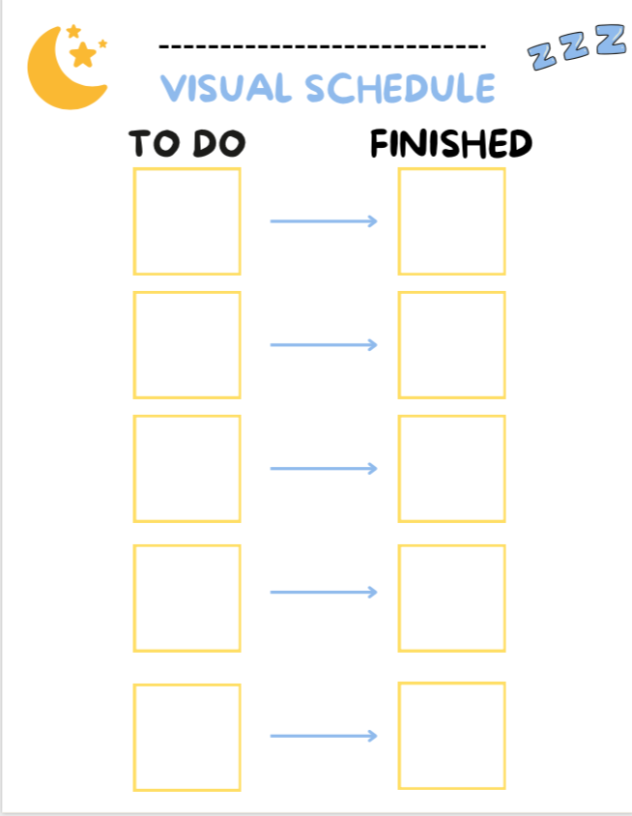
Strategies To Facilitate Sleep Routine: Visual Schedule
Can be a checklist but also pictures, objects, or photographs.
Would be helpful for children in novel situations and create choice in selecting parts of the routine encouraging autonomy.
The routine should only take around 30 minutes or less.

Slide 21
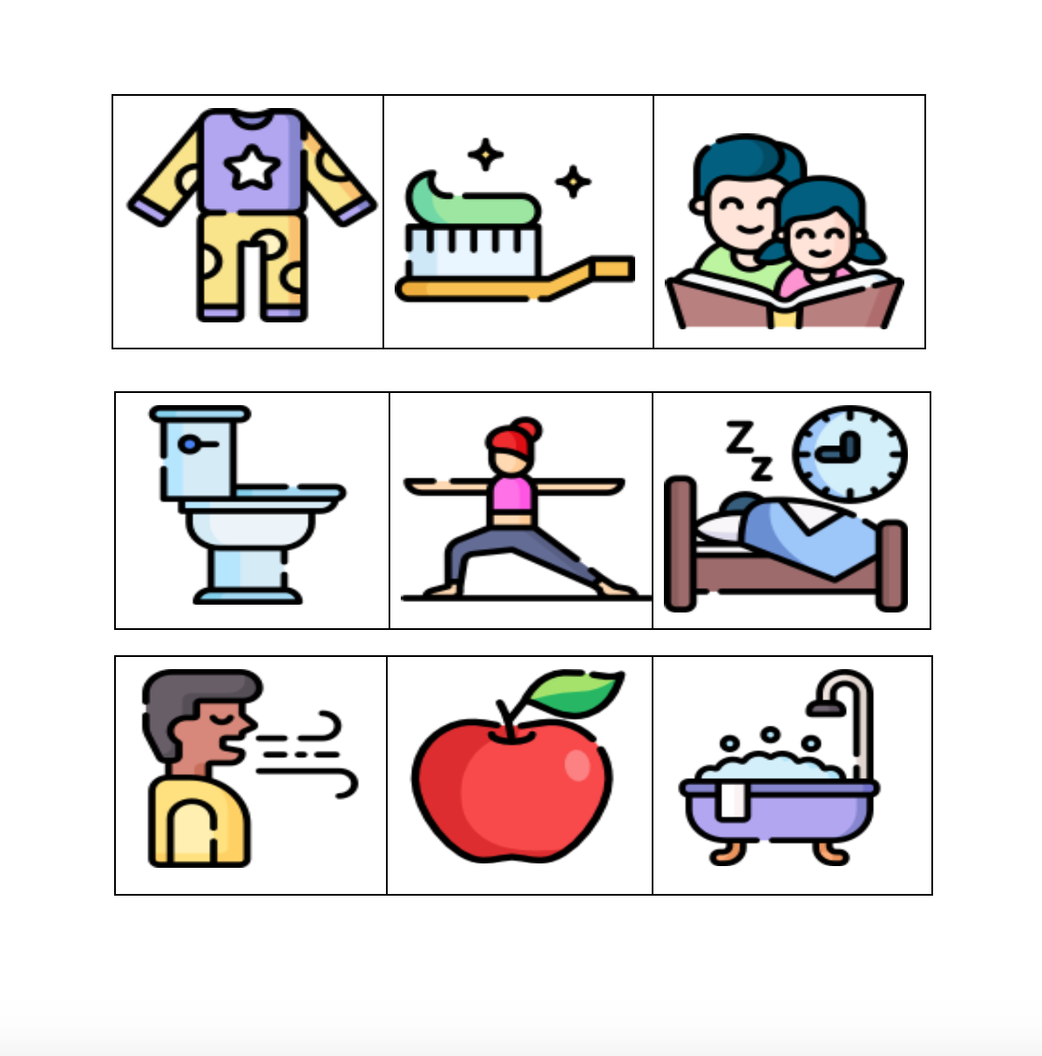
Strategies To Facilitate Sleep Routine: Visual Schedule
The items themselves can have velcro on the back to be easily moved or switched out.
Tip: Place stimulating or non preferred items early in the evening and relaxing and preferred activities closer to bedtime.
Allow your foster child to move the items over when completed and provide positive reinforcement!

Slide 22
Strategies To Facilitate Sleep Routine: Social Stories
Primarily used to explain difficult social situations and concepts in simple words
Are often personalized and can be used in a foster household to introduce the idea that they are safe and can sleep soundly.
Can Insert Name of Child, photos, etc.

Slide 23
Strategies To Facilitate Sleep Routine: Social Stories
Often includes:
Descriptive/factual statements to describe the situation.
Sentences describing what others can do to assist
Also, sentences written by the child to recall and remember what was discussed.
Can be completed with the child as a way address fears around bed time specifically
Notes:
The story can be about sleep difficulties such as sleeping alone.

Slide 24
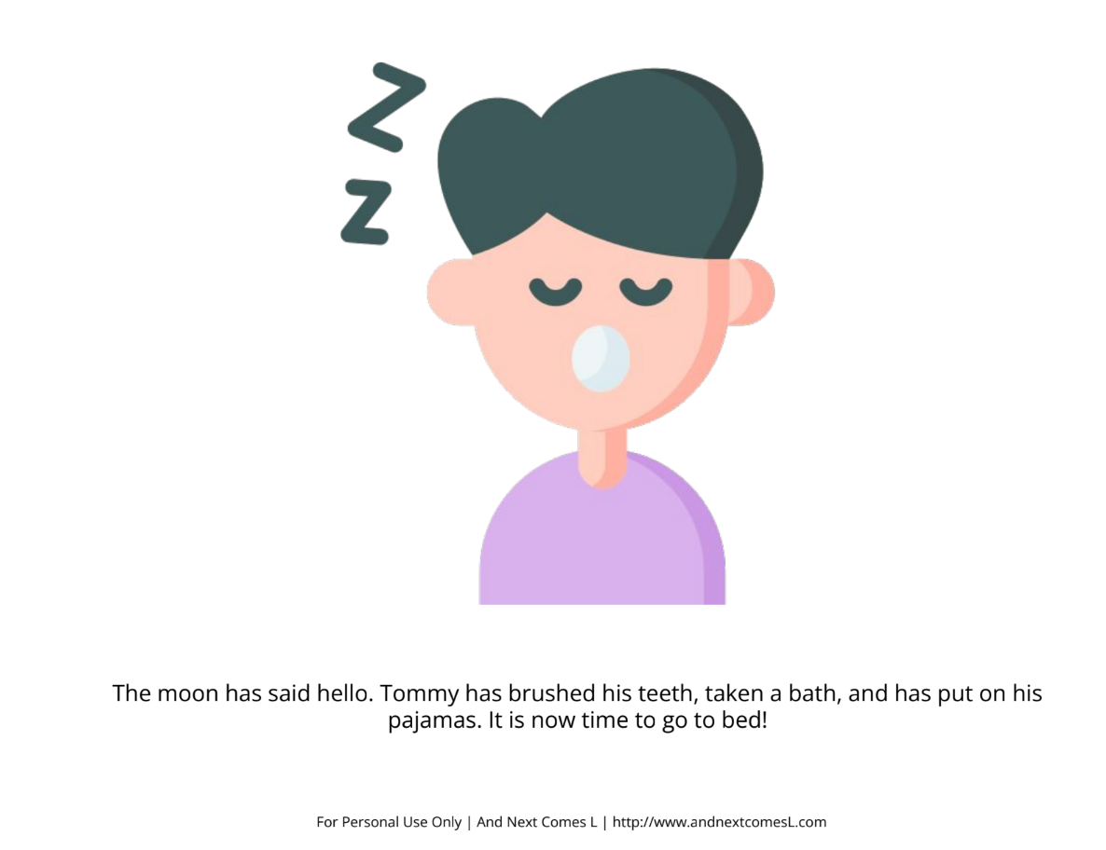
Strategies To Facilitate Sleep Routine: Social Stories

Slide 25
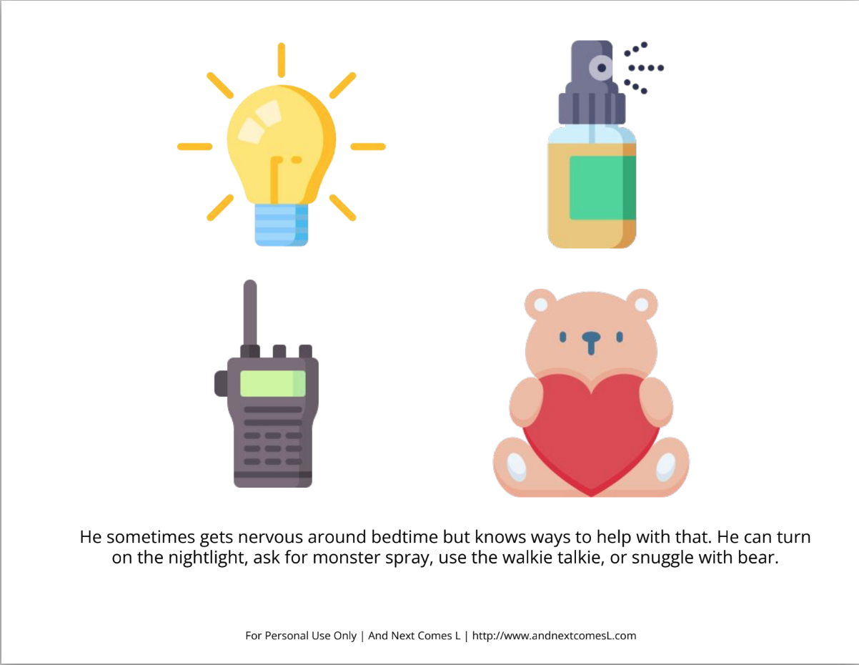
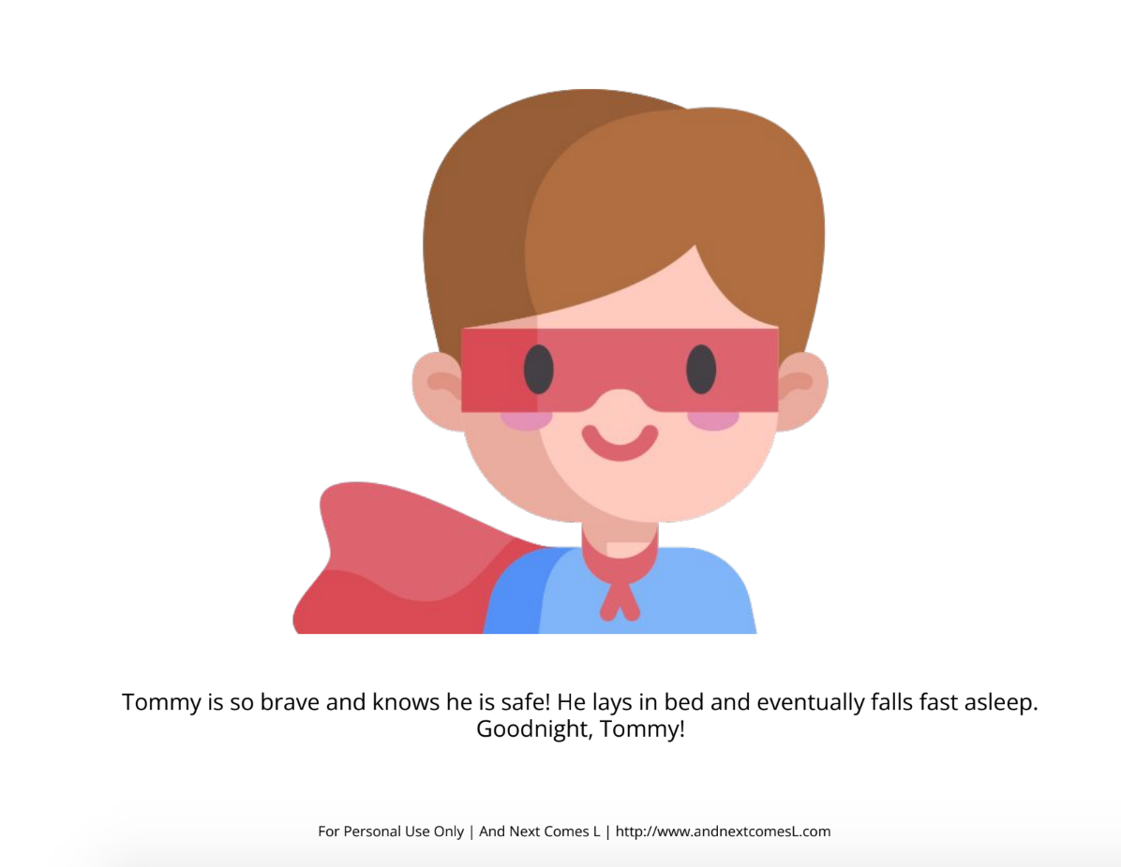
Strategies To Facilitate Sleep Routine: Social Stories

Slide 26
Strategies To Facilitate Sleep Routine: Controlled Choice
Controlled Choice describes presenting 2 or 3 choices to your foster child.
This allows the child to have a say and partake in the decision making process.
Example: “this or that?”, “how many?”, “who will help?”, “how do we do it?”
Notes:
Purple or Blue Pajamas, how many toys in the bathtub, who is going to help read brother and me?, how should we get to the bathroom? Should we walk in slow motion or bear crawl?

Slide 27
Strategies To Facilitate Sleep Routine: “Camping Out”
A good technique if your child is fearful about being alone and to build trust.
Can be used to help children fall asleep and manage night awakenings.
Done by slowly decreasing support at bedtime.

Slide 28
Strategies To Facilitate Sleep Routine: “Camping Out”
Start by sitting on the child’s bed as they fall asleep, next move to a chair, then move the chair closer and closer to the door. After a couple of nights move the chair out of view into the hallway.
You can put the child to bed at a set time and have a “check in” schedule with increasing intervals.

Slide 29
Strategies To Facilitate Sleep Routine: The Token Board For You
Another strategy to build trust is a visual representation of the number of times you have checked on the foster child.
It can be a sheet of paper, a poster, or any other means to record the amount of times you visit the child’s room during the night.
It can be used in conjunction with graduated extinction.
Notes:
A way to put action behind your words.

Slide 30
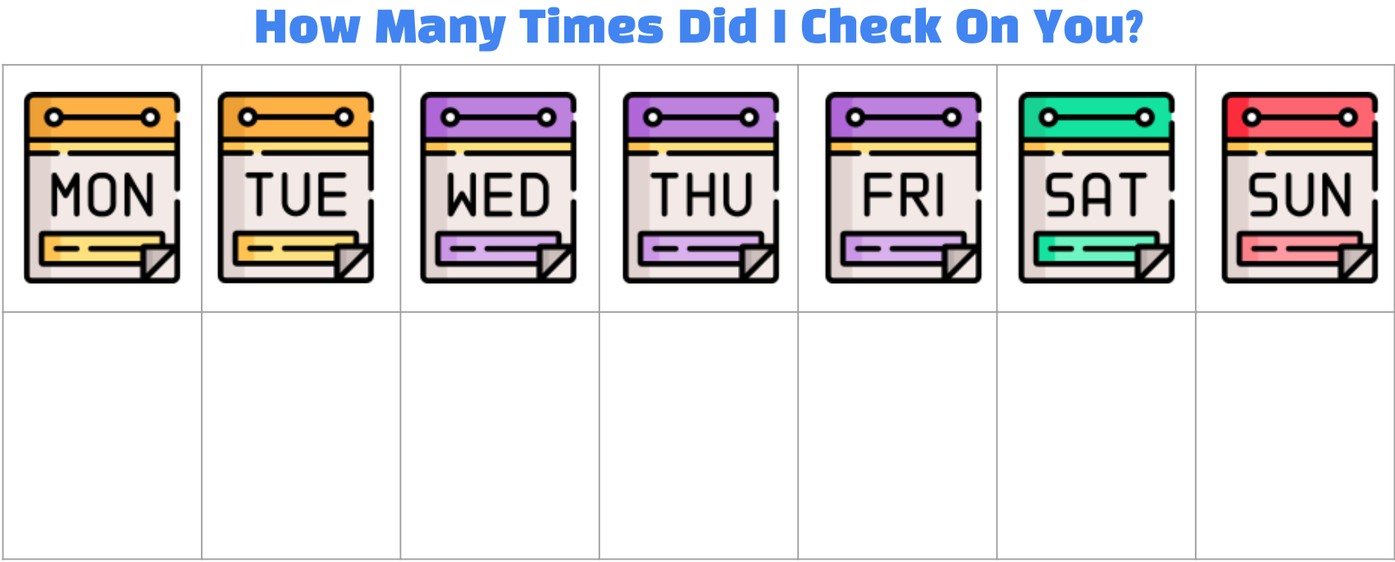
Strategies To Facilitate Sleep Routine: The Token Board For You
Ideas:
Sticker board with schedule to represent visits.
Jar with beads and once the jar is filled you can make bracelets.
Draw something every time you visit on the paper on the door or a tally mark.
Notes:
A way to put action behind your words. This can be personalized to your child. Every time you visit your child while they are sleeping this is a clear indicator in the morning to show you did so. For example, say your child loves dinosaurs. You promise to check in twice on your child during the night. You put two dinasour stickers on the sticker board or you can have a designated spot for loose stickers that represent the times you visited throughout the night.

Slide 31
Strategies To Facilitate Sleep Routine: Attachment
Attachment:
The Cycle:
Attachment and Foster Care:
It has been found that children placed before 10 months are more likely develop secure attachment. However, those placed after 10 months were more likely to display insecure behavior when distressed.
A young child’s tendency to seek nurturance, protection, support, and comfort from a caregiver
It was noted that when children avoided their foster parents, the foster parents responded with irritability and impatience
Notes:
We often revert back to the strategies our parents used for sleep. This may involve leaving the child in the room to “cry it out” and go to sleep. This is not the most effective. When trying to build trust it can cause an attachment to never form. The child will not be able to come to you for comfort.

Slide 32
Strategies To Facilitate Sleep Routine: Attachment
Foster children often have difficulty articulating what they need.
When a foster child enters your home, they have been separated from their comfort person. A caregiver who they go to for protection and support.
Forming attachment takes time. It is created through trust.
A bond is forged through consistently having emotional and physical needs addressed and met.

Slide 33
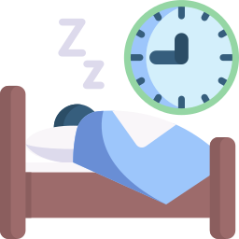
Strategies To Facilitate Your Sleep
If your foster child is not sleeping, you aren’t sleeping
It is important to model the healthy sleep hygiene you want to see in your foster children.
A strategy is to have another trusted family member or adult that has been approved watch the child while you take a nap during the day.
This way you are ready to facilitate your foster child’s bedtime routine at night.
The more you sleep, the more you will be able to fill all of your roles!
Notes:
We hope that these various techniques will aid in your sleep too!

Slide 34
04
Do’s, Don’ts, and Maybes

Slide 35
Co-Sleeping
As stated by the State of Alabama Department of Human Resources, “co-sleeping or bed-sharing is prohibited”.
Alternatives Include:
A warmable stuffie
Use a baby monitor
Go to them when they awaken and comfort them

Slide 36
Melatonin
Melatonin, in supplement form, can be given as a sleep aid.
It is required for there to be a doctors note. This supplement has to be dosed correctly.
Instead, encourage melatonin to be naturally produced via the change in lighting (dimming the lights, no blue light).

Slide 37
“Behavioral” Interventions
Specifically, contingency methods or a set of rules, instructions, directions to gain access to a desired object or activity.
Caution should be used when promoting these for foster children as all behavior is communication and serves a purpose.
Think of what behavior you are actually encouraging!

Slide 38
Scenario # 1
Samantha is a new foster child in your home who is having a hard time going to sleep. She is constantly on her tablet and tends to stay up past her bedtime. Recently, she has been going to bed at different times every night. She starts her routine and then forgets what exactly she needs to do.
What strategies discussed can you apply to aid in Samatha’s sleep from this Module?
Limit Blue Light or Blue Light Glasses
Consistent Routine with a visual schedule
Lavender, limiting noise, ensuring a cooler temperature during sleep.

Slide 39
Scenario # 2
What strategies discussed can you apply to aid in Tristen’s sleep from this Module?
Tristen is a foster child who is fearful of sleeping alone. He does not want you to leave the room after bedtime. He often responds “what if monsters get me?” or “what if I need you?”
Modified “camping out” method
Social Story
Warming Stuffie, Walkie Talkie

Slide 40
Scenario # 3
What strategies discussed can you apply to aid in Margot sleep from this Module?
Margot often will leave her room after bedtime often saying she is “not ready to go to sleep” and does not think you are going to check on her. She, during the bedtime routine, disagrees with every step or activity. She does not want to wear the pajamas you picked out for her or read the book with you.
Visual Schedule
Controlled Choice
Token Board For You!

Slide 41
Do You Want to Know More?
The Final Quiz
Scan the QR code or click the link at the bottom on this video to proceed in completing the final quiz. After you complete the quiz, there will be a survey to report your opinion on the course. We thank you for your feedback in advance.

Slide 42
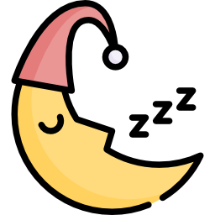
Thank You!

Slide 43
Sources
Alfano, C. A., Valentine, M., Nogales, J. M., Kim, J., Kim, J. S., Rigos, P., McGlinchey, E. L., Ripple, C. H., & Wolfson, A. R. (2022). How Are the
Sleep Problems of Children in the US Foster Care System Addressed? Journal of Developmental and Behavioral Pediatrics, 43(8), e525–e532. https://doi.org/10.1097/DBP.0000000000001090
Alnawwar, M. A., Alraddadi, M. I., Algethmi, R. A., Salem, G. A., Salem, M. A., & Alharbi, A. A. (2023). The Effect of Physical Activity on
Sleep Quality and Sleep Disorder: A Systematic Review. Cureus, 15(8), e43595. https://doi.org/10.7759/cureus.43595
Bedgood, S. (2017). Sleep it off: craft the perfect environment to get the best night’s rest. In Success (Chicago, Ill.) (pp. 15-). R & L
Publishing, Ltd. (dba SUCCESS Media).
Blunden, S. (2011). Behavioural treatments to encourage solo sleeping in pre-school children: An alternative to controlled crying.
Journal of Child Health Care, 15(2), 107–117. https://doi.org/10.1177/1367493510397623
Bryan , L. (2024, March 22). Melatonin: Usage, side effects, and safety. Sleep Foundation. https://www.sleepfoundation.org/melatonin
Canapari, C. (2024, June 30). Camping out sleep training complete guide: A gentle technique that works. Craig Canapari, MD.
https://drcraigcanapari.com/camping-out-sleep-training/
Fakhr-Movahedi, A., Mir Mohammad Khani, M., & Ramezani, H. (2018). Effect of milk-honey mixture on the sleep quality of coronary
patients: A clinical trial study. Clinical Nutrition ESPEN, 28, 132–135. https://doi.org/10.1016/j.clnesp.2018.08.015
Fuller, C., Novick, M., & Hicks, S. (2018). Bedtime Use of Technology: Effects on Sleep in Children and Adolescents. Journal of
Adolescent Health, 62(2), S124–S125. https://doi.org/10.1016/j.jadohealth.2017.11.253
Garrison, M. M., & Christakis, D. A. (2012). The Impact of a Healthy Media Use Intervention on Sleep in Preschool Children. Pediatrics
(Evanston), 130(3), 492–499. https://doi.org/10.1542/peds.2011-3153
Helm, A. F., & Spencer, R. M. C. (2019). Television use and its effects on sleep in early childhood. Sleep Health, 5(3), 241–247.
https://doi.org/10.1016/j.sleh.2019.02.009
Herz, R. S., Van Reen, E., Barker, D. H., Hilditch, C. J., Bartz, A. L., & Carskadon, M. A. (2018). The Influence of Circadian Timing on
Olfactory Sensitivity. Chemical Senses, 43(1), 45–51. https://doi.org/10.1093/chemse/bjx067

Slide 44
Sources
Howatson, G., Bell, P. G., Tallent, J., Middleton, B., McHugh, M. P., & Ellis, J. (2012). Effect of tart cherry juice (Prunus cerasus) on
melatonin levels and enhanced sleep quality. European Journal of Nutrition, 51(8), 909–916.
https://doi.org/10.1007/s00394-011-0263-7
Hulthen, A. (2022, March 1). Cutting down on power struggles and problematic behavior: Using “controlled choices.” LLA Therapy.
https://llatherapy.org/cutting-down-on-power-struggles-and-problematic-behavior-using-controlled-choices/
Kokina, A., & Kern, L. (2010). Social StoryTM Interventions for Students with Autism Spectrum Disorders: A Meta-Analysis. Journal of
Autism and Developmental Disorders, 40(7), 812–826. https://doi.org/10.1007/s10803-009-0931-0
Koulivand, P. H., Khaleghi Ghadiri, M., & Gorji, A. (2013). Lavender and the Nervous System. Evidence-Based Complementary and
Alternative Medicine, 2013(2013), 1–10. https://doi.org/10.1155/2013/681304
Knight, F. L. C., & Dimitriou, D. (2019). Poor Sleep Has Negative Implications for Children With and Without ADHD, but in Different Ways.
Behavioral Sleep Medicine, 17(4), 423–436. https://doi.org/10.1080/15402002.2017.1395335
Lin, H. H., Tsai, P. S., Fang, S. C., & Liu, J. F. (2011). Effect of kiwifruit consumption on sleep quality in adults with sleep problems. Asia
Pacific journal of clinical nutrition, 20(2), 169–174.https://doi.org/10.6133/apjcn.2011.20.2.05
National Institute of Child Health and Human Development. (2018, April). What Does A Safe Sleep Environment Look Like?
O’Brien, J. C., & Kuhaneck , H. (2020). Behavioral Approaches.. In Occupational Therapy for Children and Adolescents (Eighth, pp.961,
977, 521-538). essay, Elsevier, Inc.
Owens, J. (2024, February). Pharmacotherapy for insomnia in children and adolescents: A rational approach. In R. Chervin & A. Eichler
(Ed.). UpToDate. https://www.uptodate.com/contents/pharmacotherapy-for-insomnia-in-children-and-adolescents-a-rational-approach
Pacheco, D. (2023, November 8). Children and sleep. Sleep Foundation.
https://www.sleepfoundation.org/children-and-sleep#references-78714
Spagnola, Mary, and Barbara H. Fiese. “Family Routines and Rituals: A Context for Development in the Lives of Young Children.”
Infants and Young Children, vol. 20, no. 4, 2007, pp. 284–99, https://doi.org/10.1097/01.IYC.0000290352.32170.5a.

Slide 45
Sources
State of Alabama Department of Human Resources. (2019, April 1). Minimal Standards For Foster Family Homes .
Stovall-McClough, K.C. & Dozier, M.(2004). Forming attachments in foster care: Infant attachment behaviors during the first 2 months
of placement. Development and Psychopathology, 16(2), 253–271. https://doi.org/10.1017/S0954579404044505
Summer , J., & Adavadkar, P. (2023, September 13). What color light helps you sleep?. Sleep Foundation.
https://www.sleepfoundation.org/bedroom-environment/what-color-light-helps-you-sleep
Wong, N. A., & Bahmani, H. (2022). A review of the current state of research on artificial blue light safety
as it applies to digital devices. Heliyon, 8(8), e10282. https://doi.org/10.1016/j.heliyon.2022.e10282
Zeanah, C. H., Berlin, L. J., & Boris, N. W. (2011). Practitioner Review: Clinical applications of attachment theory and research for infants
and young children. Journal of Child Psychology and Psychiatry, 52(8), 819–833. https://doi.org/10.1111/j.1469-7610.2011.02399.
Zeanah, C. H., Shauffer, C., & Dozier, M. (2011). Foster Care for Young Children: Why It Must Be Developmentally Informed. Journal of the
American Academy of Child and Adolescent Psychiatry, 50(12), 1199–1201. https://doi.org/10.1016/j.jaac.2011.08.001
Zerbini, G., Kantermann, T., & Merrow, M. (2020). Strategies to decrease social jetlag: Reducing evening
blue light advances sleep and melatonin. The European Journal of Neuroscience, 51(12), 2355–2366. https://doi.org/10.1111/ejn.14293

Slide 46
Resources
Visual Schedule Template
Social Story Template
Visual Schedule Cutouts
Adult Visual: How Many Times Did I Check On You?

