Slide 1


Module 2
Sleep and the Senses: Strategies to Create an Environment that Encourages Sleep
Madison Bowen
Occupational Therapy Student at the University of Alabama at Birmingham

Slide 2
01
02
03
Sensory Systems
What Is Regulation and Co-Regulation?
Interventions For Sleep: Activities
04
Interventions For Sleep: Environment

Slide 3
01
Sensory Systems

Slide 4

Our Basic Senses
These senses make up our perception of the world around us.
Would you be surprised that these senses do not paint a full picture?
Visual
  Sight
Auditory
  Sound
Olfactory
  Smell
Gustatory
  Taste
Tactile
  Touch

Slide 5
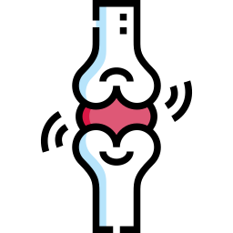

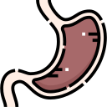
Proprioceptive System
  There are receptors in the skin and muscles but also ligaments, connective tissues, joints, and tendons. When those receptors stretch, it lets us know the position of our body parts.
Vestibular System
  The hair cells in our inner ear work almost like a carpenter's level. They note every positional change and head movement. This system tells us where our heads and body are in space.
Interoceptive System
  Interceptors are sensors in the body that give us a sense of what our internal organs are feeling.
The 3 Additional Senses

Slide 6



What Is Regulation vs Dysregulation ?
Self Regulation
Dysregulation
It is the ability to control the way we act and feel. It is the ability to attend what is going on around you. It is also the skill to then take action from that information and return to a state of balance.
This is experiencing sensations but being unable to return to equilibrium.

Slide 7



What Is Dysregulation?
Modulation
Under-Responsive
Over-Responsive
Sensory Seeker
The ability to adjust the responses to the sensations.
The child requires a lot of stimulation to register stimulation.
The child is very sensitive to sensations in the environment.
The child actively is looking for sensory experiences.

Slide 8
What Can Dysregulation Look Like?
Example 1
Example 2
Example 3
Example 4
Example 5
Craves fast movement and is constantly fidgeting
Avoiding any touch from others or wearing certain clothes
Sensory Seeker
Over-Responsive
Covering eyes, avoiding eye contact, very sensitive to bright light
Ignoring certain sounds and voices
May not notice being hungry, thirsty, or sick
Under-Responsive
Over-Responsive
Under-Responsive

Slide 9
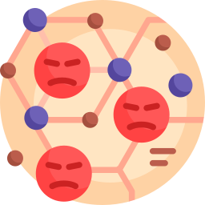
Dysregulation and Foster Children
Our Stress Response
This response is dysregulating!
As discussed in Module 1, our stress response is activated by our brain or more specifically the Hypothalamic-Pituitary- Adrenal Axis. This is main contributor to the release of cortisol in the body.
This release is a reaction to stressors or triggers, from past trauma, in the environment.
This activates our sympathetic nervous system creating a response.
Those who are survivors of trauma often over-or-under-respond to sensory stimulation.

Slide 10

Self Regulation and Foster Children
The amygdala becomes dysregulated as an early response to trauma.
This part of the brain controls the regulation of emotions.
This can overwhelm a child’s developing coping skills and produce an automatic reaction to a threat.
This can include what looks like extreme reactions to minor stressors. (aggression, out-bursts etc.)
In fact, this can cause a tendency towards dysregulation.

Slide 11
02
Co-Regulation and Regulation

Slide 12
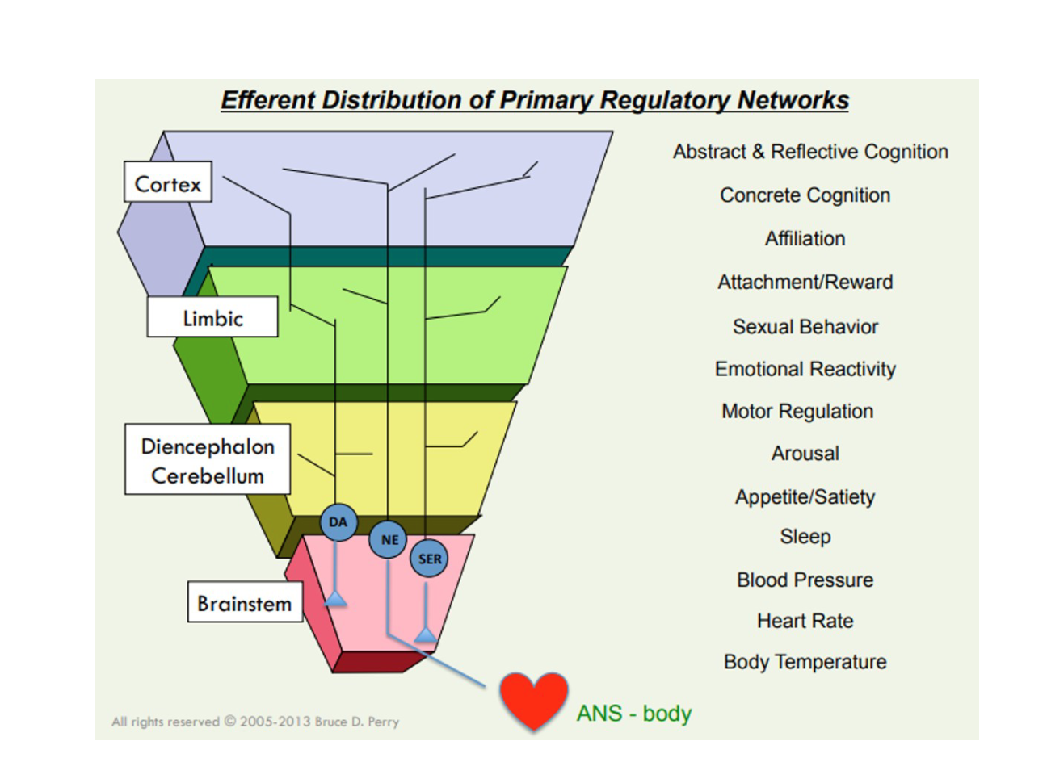



Regulate, Relate, Reason
A Brain With Trauma
Reason
This is a model of the regulatory networks. Going from the bottom to the top you see that basic needs comes first then the ability to have any sort of cognition.
This means that we need to regulate first in situations of stress. Finally, then the child will be able to have the internal resources to meet requests or demands.
Relate
Regulate
Perry , B. D. (2022, April 2). Regulate, Relate, and Reason (Sequence of Engagement): Neurosequential Network Stress & Trauma Series . YouTube. https://www.youtube.com/watch?v=LNuxy7FxEVk

Slide 13



Regulate, Relate, Reason
Regulate
2. Relate
3. Reason

Slide 14
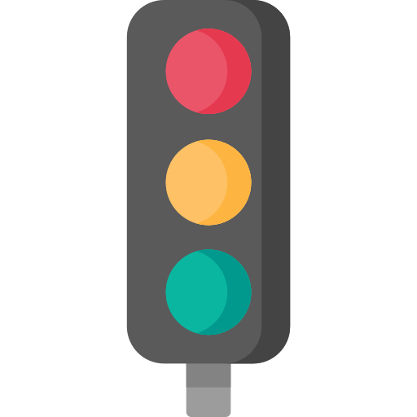
Regulate, Relate, Reason
Example
Often, it is easy to begin with reasoning. This is like trying to drive through a red light!
Your foster child, Sarah, is nearing her bed time. When you say it is time to go to sleep, she starts to panic. She is noted to begin crying and throws her stuffed animal across the room. She then runs to another room.
What do you do?

Slide 15

Co-Regulation
What Is Co-Regulation?
Co-Regulation is a technique that allows a caregiver and child to connect when a child is in distress. This helps a child learn to navigate those difficult emotions.
Early childhood experiences shape autonomic activity but people can learn through this technique to regulate their emotions and response patterns.

Slide 16

Co-Regulation
What Is Co-Regulation?
Our brains are able to register the emotions of others in our environment. As you are co-regulating with your child, the mirror neurons are activated. This means the child is able to look at the caregiver and mirror their emotions during dysregulation.

Slide 17
Co-Regulation: A.G.I.L.E Technique
Affect
Gesture
Intonation
Latency
Engagement
What do your facial expressions, hand gestures, body movements, posturing, and pacing saying?
Modulating the tone of your voice helps convey affect and social/emotional meaning. This is felt and understood long before words
How your tone and expressions convey your emotions. In times of stress is your affect loving and soothing?
Give the child time to process your affect, gestures, and intonation
Before you continue, make sure the child is engaged.

Slide 18
03
Regulation Activities to Aid in Sleep

Slide 19



Breathing Techniques
Mindful Breathing
Resonance Breathing
Diaphragmatic breathing
This involves a voluntary change in rate, quality, and pattern of respirations. It works by reducing heart rate and blood pressure or sympathetic activity from the nervous system.

Slide 20



Breathing Techniques
Dandelion Breathing
Belly Breathing
Breathe in through the nose
Hold that breathe for 2 seconds
Breathe out through the mouth for 6 counts
Repeat
Place one hand on your stomach.
Inhale through your nose for 4 seconds.
Pretend your belly is a balloon and make it push your hand.
Hold your breath for 2 seconds.
Exhale for 4 seconds.

Slide 21

Guided Imagery
This is the process of visualizing imagery in the mind. It combines body relaxation and the imagery portion to improve mood and well-being as well as reduce blood pressure and manage anxiety.
The first step involves body relaxation for the toes to the head.
Then you begin the guided imagery. At this step, the child is asked
to visualize a place or scenario.
The child then returns to reality.

Slide 22

Guided Imagery
A child can do this on their own, through an audio recording, or be facilitated by you.
It is similar to daydreaming in that they can pick a favorite place and picture themselves there.
Notes:
Alternatively, I can make my own example and post on youtube

Slide 23

Progressive Muscle Relaxation
PRM is a deep muscle relaxation technique. It is proven to reduce:
  Stress
  Anxiety
  Insomnia
The technique itself does this by lowering heart rate, decreasing blood pressure, and slowing down respirations.
PRM involves tensing one muscle at a time followed by a relaxation phase of releasing the tension.
The relaxation phase is longer than the active phase.
Example: Hold the pose for 5 seconds and relax for 15 seconds.

Slide 24
Progressive Muscle Relaxation
Sample Script: Toes: “Pretend you are a parrot on a branch in the rainforest and squeeze your toes to hold onto a branch”
Legs: “Remember the feeling when you squeezed your toes and now try your lower leg. Then, your upper leg”
Stomach: “Make your stomach hard like armor and squeeze your muscles”
Hands: “Act like you a squeezing a ball in each hand”
Arms: “Reach up above your head and try to touch the stars”
Head/Shoulders: “Try to make your shoulders touch your ears like someone is tickling you”
Face: “Make the silliest faces you can think of! Then, Relax”

Slide 25
Autogenic Training
Autogenic training involves visualizing heaviness and warmth of the legs and arms. This is followed by the strength of the organs, heart, and breathing.
It can reduce hyperarousal, stress and increase self-regulation.
This can be done lying down or sitting. The eyes should be closed while completing this technique. You can follow a recording or repeat the steps to yourself.

Slide 26

Yoga
Yoga provides proprioceptive input organizing the system.
It is found to reduce stress, anxiety, and increase coping skills in some children.
Practicing yoga while deep breathing can move the child from fight or flight into a rest and renew state

Slide 27



Yoga
Hold the poses for 2-3 minutes while deep breathing.
This can be facilitating by watching videos, reading a yoga story time book together, or modeling the poses for your foster child.
Example: Tree Pose, Mountain Pose, Butterfly Pose

Slide 28
03
Environmental Strategies For Sleep

Slide 29






Environmental Strategies: Proprioception
Bubble Mountain at bathtime
Weighted Blanket
Guidelines: 10% of weight
Example: 100 pounds= 10 pound weighted blanket
Spandex PJs and Sheets
Tucking the sheets on both sides of the mattress
Two body pillows on each side for compression
Roll in Blanket

Slide 30





Environmental Strategies: Auditory
Noise Blocking Curtains
Sound Machine
Fan
Soothing Music
Noise Door Blocker

Slide 31





Environmental Strategies: Vestibular and Visual
Linear, rhythmical, gentle swinging in a hammock
Or
Rocking in a quiet place
Limiting Blue Light Exposure
A Nightlight
Blackout Curtains/darkening shades
Dimming the lights in room or house as bed time approaches

Slide 32






Environmental Strategies: Implementing Choice
Baby Monitor for Night Awakenings/ Walkie Talkie
Controlling lighting
Door Open or Closed
Comfort Item
Allowing foster sibling to sleep in the same room (if appropriate)
Allowing child to choose pjs, bath toys, what to read

Slide 33

An Important Note
Every foster child is unique and has individual sensory needs around sleep. Some strategies may not be appropriate for your foster child and that is normal!

Slide 34

Scenario Question # 1
Jamie is a 10 year old who, when it is around bedtime, is go go go. He is constantly running around in a state of hyperarousal. What are some strategies you think would be helpful for Jamie to facilitate sleep?
Answer: Anything with deep pressure to organize the proprioceptive system! It could be progressive muscle relaxation or yoga.
For environmental strategies, you can try a weighted blanket, spandex sheets, and at bath time using a straw to blow the bubble mountain.

Slide 35
Scenario Question # 2
Angel is a 8 year old who has a lot of fear around bed time. She often is leaving her room after her bedtime routine is complete. You know that at her biological parents house she is used to a lot of other family members being present.
Answer: Asking the social worker additional information about sleeping arrangements can be helpful. Promoting the feeling of safety is incredibly important and can be done through providing a walkie talkie, replicating a comfort item, a nightlight, and soothing music.
You can also consider breathing exercises!

Slide 36
Do You Want to Know More?
Module 3: Increasing Independence and Confidence Around Sleep Through Choice

Slide 37
Sources
Bougea, A., Spantideas, N., & Chrousos, G. P. (2018). Stress management for headaches in children and adolescents: A review and
practical recommendations for health promotion programs and well-being. Journal of Child Health Care, 22(1), 19–33. https://doi.org/10.1177/1367493517738123
Costa , G. (2022, April). Teaching with no labels: an agile approach to ASD. Exceptional Parent Magazine , 25–27. Retrieved 2024, from
https://reader.mediawiremobile.com/epmagazine/issues/207830/viewer?page=27.
Effective Responses To Trauma . WVPBIS. (2016). https://wvpbis.org/classroom-pbis/
Gerson, R., & Rappaport, N. (2013). Traumatic stress and posttraumatic stress disorder in youth: Recent research findings on clinical
impact, assessment, and treatment. Journal of Adolescent Health, 52, 137–145.
Halaseh, D., & Family Flavours. (2023). Trauma and the brain: Regulate, relate and reason. In TCA Regional News. Tribune Content
Agency LLC.
Khunti, K., Boniface, S., Norris, E., De Oliveira, C. M., & Nicola Shelton (2023). The effects of yoga on mental health in school-aged
children: A Systematic Review and Narrative Synthesis of Randomised Control Trials. Clinical child psychology and psychiatry, 28(3), 1217–1238.
Kranowitz, C. S., & Miller, L. J. (2022). The out-of-sync child: Recognizing and coping with sensory processing differences. A
TarcherPerigee Book.
Merakou, K., Tsoukas, K., Stavrinos, G., Amanaki, E., Daleziou, A., Kourmousi, N., Stamatelopoulou, G., Spourdalaki, E., & Barbouni, A.
(2019). The Effect of Progressive Muscle Relaxation on Emotional Competence: Depression–Anxiety–Stress, Sense of Coherence, Health-Related Quality of Life, and Well-Being of Unemployed People in Greece: An Intervention Study. Explore (New York, N.Y.), 15(1), 38–46. https://doi.org/10.1016/j.explore.2018.08.001

Slide 38
Sources
Perry , B. D. (2022, April 2). Regulate, Relate, and Reason (Sequence of Engagement): Neurosequential Network Stress & Trauma
Series . YouTube. https://www.youtube.com/watch?v=LNuxy7FxEVk
Romas, J. A., & Sharma, M. (2022). Practical Stress Management: A Comprehensive Workbook, Eighth Edition (Eighth Edition). Elsevier Science
and Technology Books, Inc.
Shafir, T. (2016). Using Movement to Regulate Emotion: Neurophysiological Findings and Their Application in Psychotherapy. Frontiers in
Psychology, 7, 1451–1451. https://doi.org/10.3389/fpsyg.2016.01451
Tfi. (2023, October 6). Helping your new foster child to sleep well. TFI.
https://tfifamily.org/helping-new-foster-child-sleep-well/?gad_source=1&gclid=CjwKCAjw8rW2BhAgEiwAoRO5rKM1V4MlMYsPcjjb5Xij-qDbZi0WGJqdzCQ5ZlFCKdvGGLJX3GZhBhoCmwkQAvD_BwE
Voss , A. (2014). The Sensory Side of Sleeping... Sleep Challenges. A Sensory Life! http://asensorylife.com/sleep-challenges.html
Warner, E., Koomar, J., Lary, B., & Cook, A. (2013). Can the Body Change the Score? Application of Sensory Modulation Principles in the Treatment
of Traumatized Adolescents in Residential Settings. Journal of Family Violence, 28(7), 729–738. https://doi.org/10.1007/s10896-013-9535-8
Zisopoulou, T., & Varvogli, L. (2023). Stress Management Methods in Children and Adolescents: Past, Present, and Future. Hormone Research in
Paediatrics, 96(1), 97–107. https://doi.org/10.1159/000526946

Slide 39
Resources
Guided Imagery Audios
Sample Script For Autogenic Training
Breathing Exercises
Yoga Poses For Kids
Yoga Book
A.G.I.L.E. Approach Handout

Slide 40
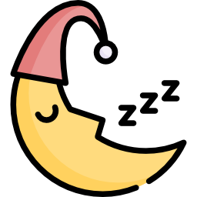
Thank You!

